Slide 1
Marketing

Slide 2
Marketing
A process by which a firm profitably translates customer needs into revenue

Slide 3
DEFINITION OF MARKETING
The process of planning and executing the conception, pricing, promotion and distribution of ideas, goods, and services to create exchanges that satisfy individual and organizational objectives.

Slide 4
Marketing environment

Slide 5
The forces that directly and indirectly influence an organization’s capability to undertake its business
The forces that directly and indirectly influence an organization’s capability to undertake its business

Slide 6
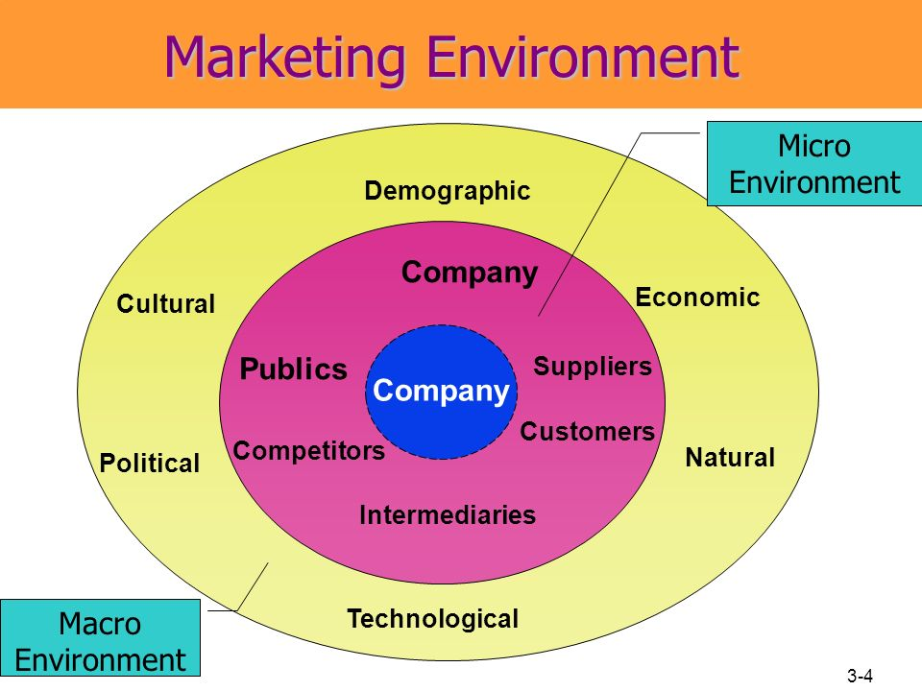

Slide 7
Marketing mix

Slide 8
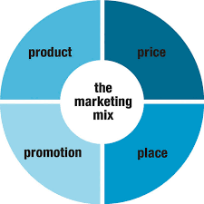

Slide 9
It is about putting the right product or a combination thereof in the place, at the right time, and at the right price
A marketing expert named E. Jerome McCarthy created the Marketing 4Ps in the 1960s. This classification has been used throughout the world

Slide 10
Product
A product is an item that is built or produced to satisfy the needs of a certain group of people.
The product can be intangible or tangible as it can be in the form of services or goods.
You must ensure to have the right type of product that is in demand for your market.
So during the product development phase, the marketer must do an extensive research on the life cycle of the product that they are creating.

Slide 11
In developing the right product, you have to answer the following questions:
What does the client want from the service or product?
How will the customer use it?
Where will the client use it?
What features must the product have to meet the client’s needs?
Are there any necessary features that you missed out?
Are you creating features that are not needed by the client?
What’s the name of the product?
Does it have a catchy name?
What are the sizes or colors available?
How is the product different from the products of your competitors?
What does the product look like?

Slide 12
Price
The price of the product is basically the amount that a customer pays for to enjoy it. Price is a very important component of the marketing mix
It is also a very important component of a marketing plan as it determines your firm’s profit and survival.
Pricing always help shape the perception of your product in consumers eyes.

Slide 13
Here are some of the important questions that you should ask yourself when you are setting the product price:
How much did it cost you to produce the product?
What is the customers’ perceived product value?
Do you think that the slight price decrease could significantly increase your market share?
Can the current price of the product keep up with the price of the product’s competitors?

Slide 14
Place
Placement or distribution is a very important part of the product mix definition.
You have to position and distribute the product in a place that is accessible to potential buyers.
This comes with a deep understanding of your target market.

Slide 15
Here are some of the questions that you should answer in developing your distribution strategy:
Where do your clients look for your service or product?
What kind of stores do potential clients go to? Do they shop in a mall, in the supermarket, or online?
How do you access the different distribution channels?
How is your distribution strategy different from your competitors?
Do you need to sell in an online store?

Slide 16
Promotion
Promotion is a very important component of marketing as it can boost brand recognition and sales
Advertising typically covers communication methods that are paid for like television advertisements, radio commercials, print media, and internet advertisements
Public relations, on the other hand, are communications. This includes press releases, exhibitions, sponsorship deals, seminars, conferences, and events.
Word of mouth is also a type of product promotion.

Slide 17
In creating an effective product promotion strategy, you need to answer the following questions:
How can you send marketing messages to your potential buyers?
When is the best time to promote your product?
Will you reach your potential audience and buyers through television ads?
Is it best to use the social media in promoting the product?
What is the promotion strategy of your competitors?

Slide 18
THANKYOU☺☺

